Slide 1
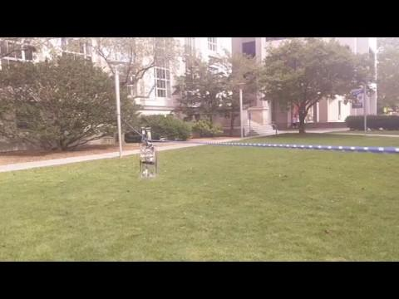
OTIS Mission Results
Mitch, Chacko, Sravani, Roberto, Jacob
BWSI Build a Cubesat 2019

Slide 2



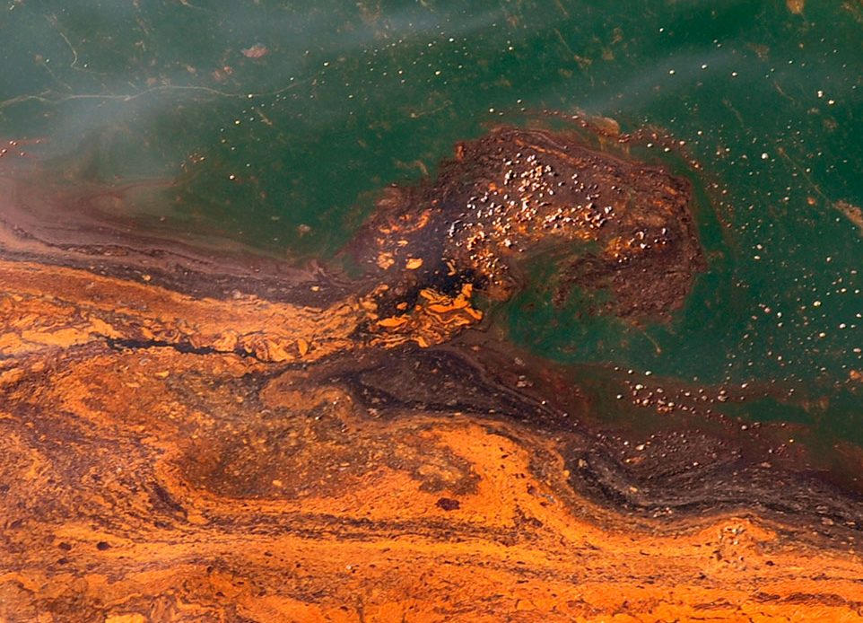
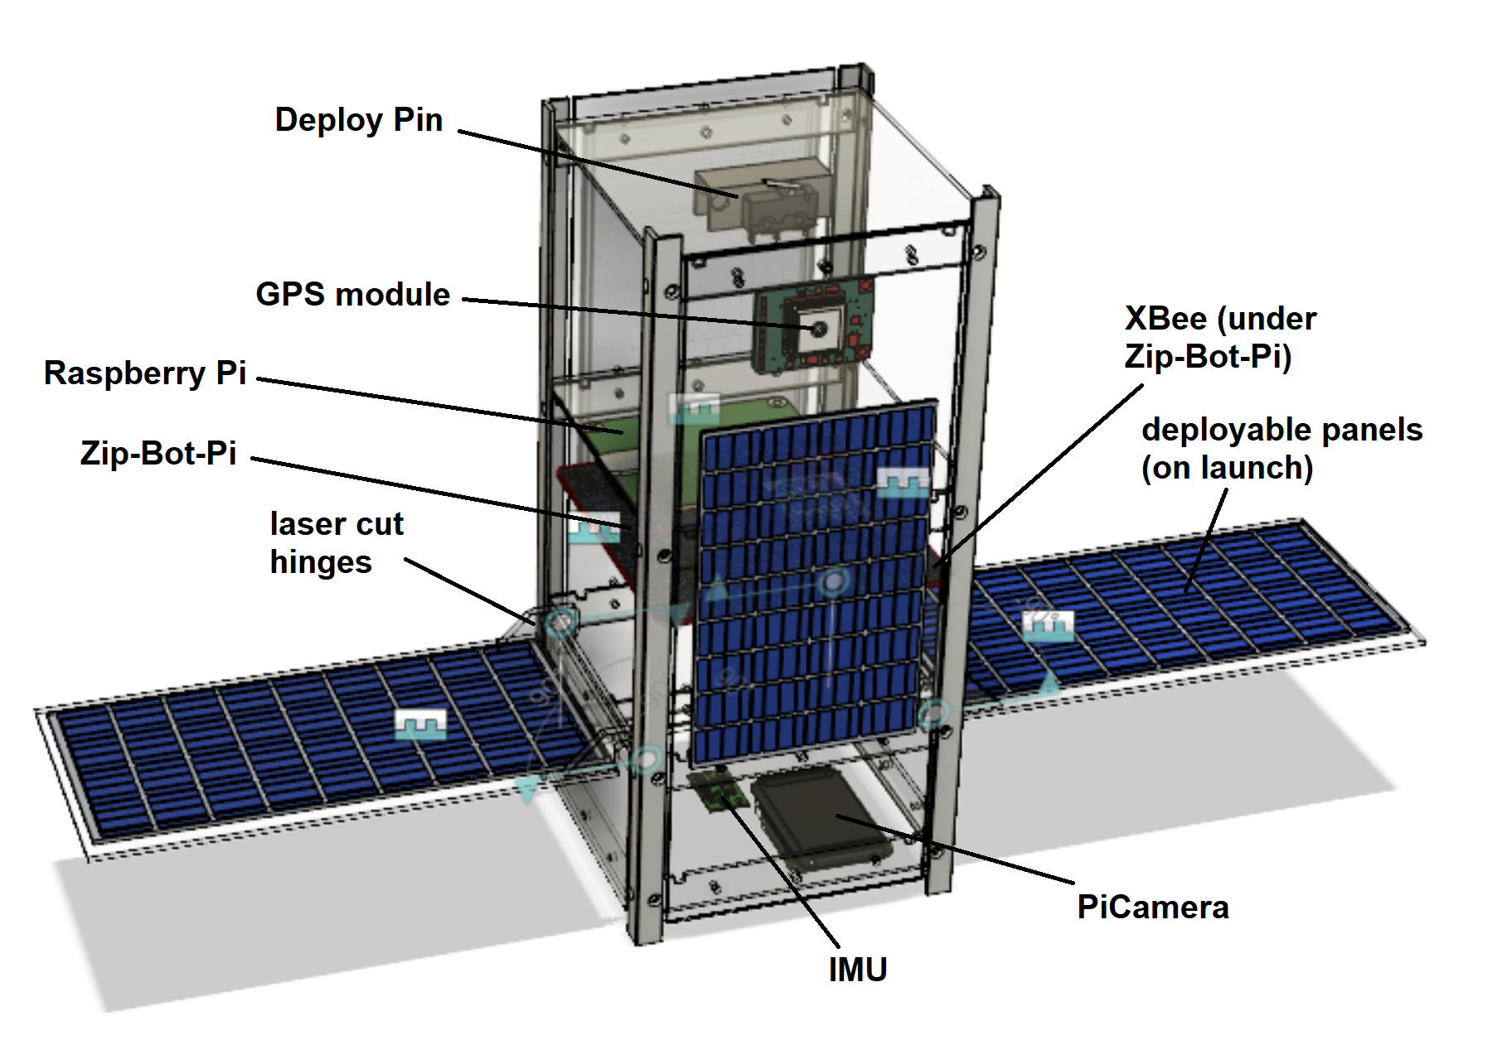
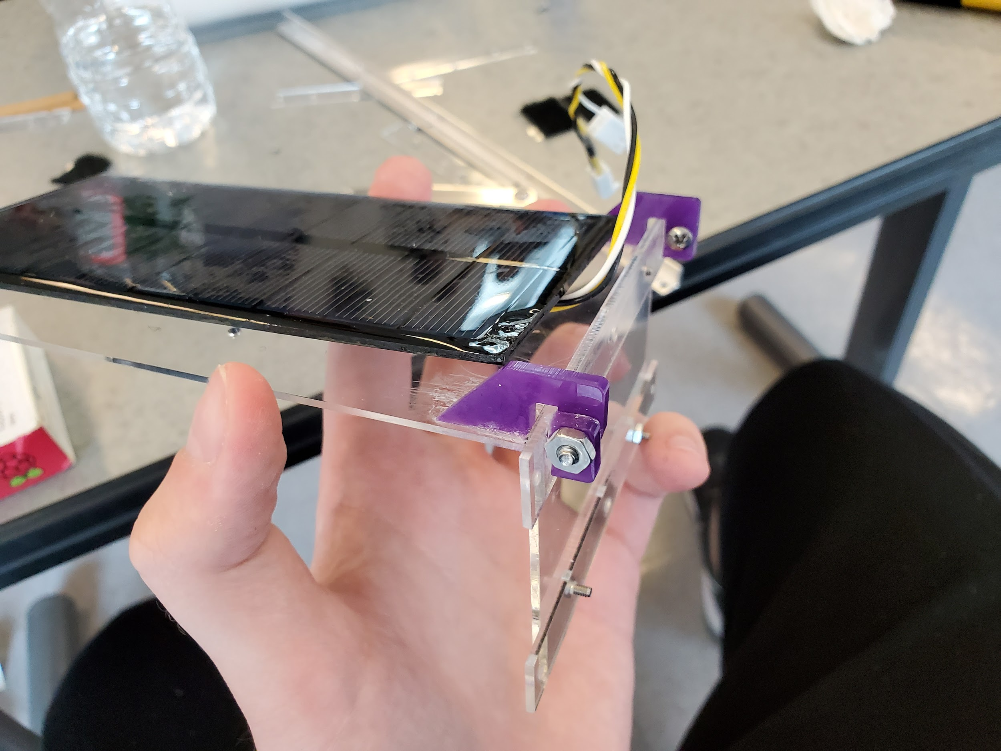
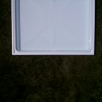
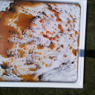
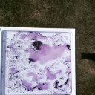
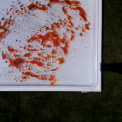
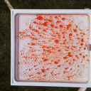
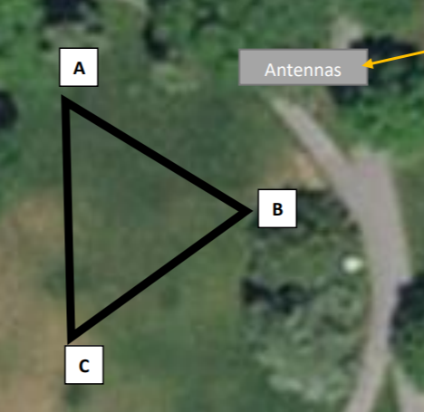
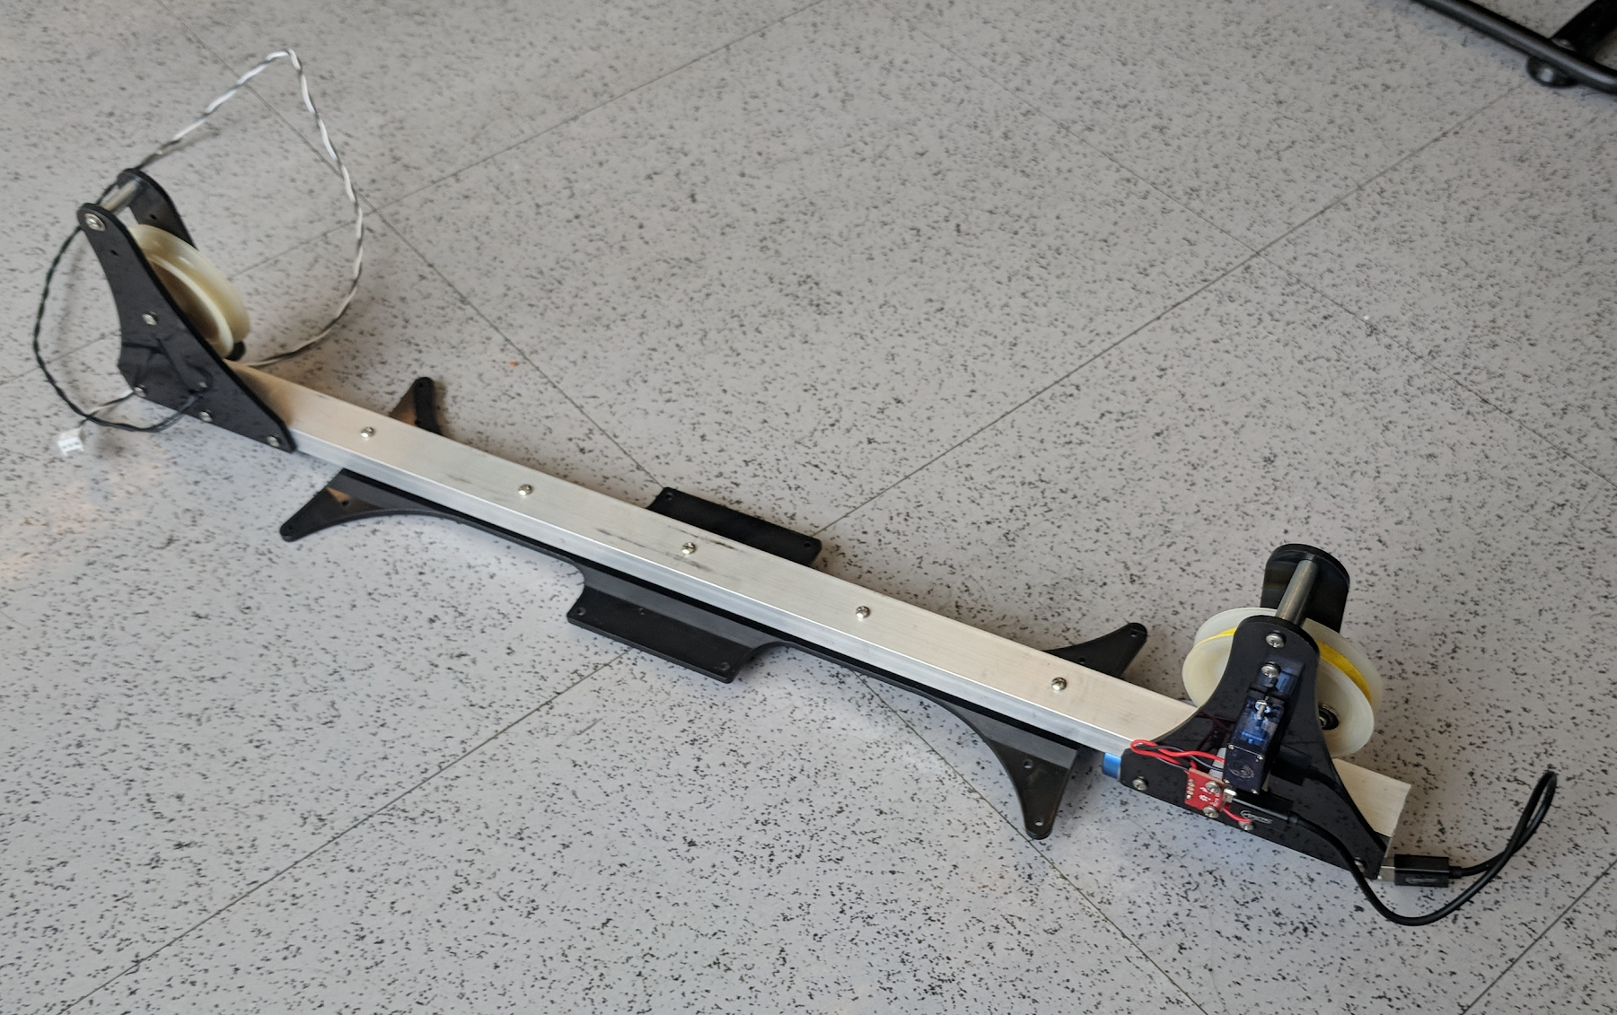
Oil Tracking Imaging System (OTIS-2U)
Modeling a LEO Cubesat mission to estimate oil spill oxidation for effective
dispersant application
Jacob Pustilnik, Sravani Boggaram, Roberto Groza, Mitchell Henderlong, Chacko Mathai | July 31, 2019
Background
Design/Development Process
Unexpected Occurrences/Errors
Time is crucial for effective response to oil spills. To hasten oil degradation before the oil damages shorelines, response crews dump dispersant, a soapy substance that breaks oil into small droplets and thereby increase surface area for natural removal by microbes, diffusion, or volatilization. However, oil exposed to sunlight undergoes photochemical oxidation. Dispersant is significantly less effective on oxidized oil; dispersant effectiveness (DE) decreases nearly linearly, by 30% after 24 hours of continuous simulated sunlight exposure (Ward et al., 2018). The EPA advises that dispersants only be applied to water where
45% or less of oil is oxidized to lower costs.
To help response crews choose ideal areas
to drop dispersant, a small, inexpensive
Cubesat could be put into LEO to image
potential sites or automatically determine
critical areas. This project simulates such a
Cubesat mission that identifies the amount
of weathered oil in a given ocean area to guide the use of dispersants.
Most of the hardware development process centered around the CAD model to show in the Critical Design Review (CDR) presentation before the mission and to reference to orient the numerous parts and deployable solar panels to fit in the space constraints, to fit into a 2U size. Avionics, flight software, and device drivers were recycled from a precursor project. The team split into specialized groups to refine and integrate the software for the radio, IMU, and GPS, each as a Python object class to be called in a main running file.
The orbit leg with the oil pans was different on-site than was planned
Solar panel hinges (glued to the frame) broke off during setup
Battery immediately cut off likely due to overload from solar panels
Radio did not transmit any data
Power connector broke during repair time
GPS data was unreliable, not implemented
Changed to take picture every 0.5 sec instead of upon seeing an oil pan
Battery and SD card were difficult to access
GPS cable was too long, solar panel cables were too short
Numerous errors delayed the 2-hour mission and left only 30 minutes for flight with modified CONOPS and flight software. These errors resulted from inadequate testing and validation within the seven days given to build OTIS-2U. For a later mission to be successful, a future satellite should undergo more in-depth testing, including adding wires to the CAD model, running a structural simulation, and testing completed flight software in conditions close to the mission target.
Figure 1: Oxidized oil
(Cabell Davis © WHOI)
Figure 4: Final CAD model for OTIS-2U Cubesat
Figure 5: Hinge laser cut from purple acrylic for deployable solar panel
Mission Data
Conclusion and Discussion
Mission Plan
Though the design and flight phases had numerous problems, OTIS tentatively supports the feasibility of such a mission. However, OTIS also highlights all of the challenges, both technical and organizational, of designing a satellite. Any object for any mission, either above or below the atmosphere, must undergo extensive planning and validation, both of structure and software. The OTIS software was rushed; it was created with the intent of being completed quickly instead of validating each section of code before integration. OTIS also needed a stricter CONOPS to guide development. Despite these shortcomings, with what data was collected OTIS shows that a Cubesat could, in fact, be used to track oil spill oxidation. The underlying concepts and algorithms are essentially simple and can be easily applied to an actual mission to help oil cleanup crews.
The simulated environment is a triangle of bungee cords over which the satellite, OTIS-2U, passes over on a powered tram. On one leg there are five pans with colored simulation oil in water. OTIS-2U was designed to be semi-autonomous. It would identify oil pans on the ground, process a high-resolution 1024x1024 image for oxidation, and send both the calculation and a 128x128 image to the ground station laptop with telemetry
Figure 6: Images retrieved from OTIS-2U after mission and processed for oxidation and dispersant need
Mass Budget
Data Budget
Power Budget
Link Budget
Money Budget
Estimated Mass: 0.900 Kg (+15% margin of error)
Actual Mass: 0.720 Kg
Estimated data: 9.83 ± 2.457 Mb
Actual data: 12.24Mb
Estimated time to send one 128x128 image: 7.26 sec + 7 sec margin of error
Estimated power use: 5.5 Wh (+20% margin of error)
Actual power use: 2.26 Wh
-Received Power: -80 dBm
-Required SNR: -4 dB
-Link Margin: -4.03 dB
-Noise Level: -76 dB
Maximum Range: 50 m
Estimated Cost: $450 (+25% margin of error)
References
Figure 2: Map of orbit triangle at Woods Hole Oceanographic Institute (WHOI)
Figure 3: Powered tram to which OTIS is attached that rolls across zip line
Ward, Collin P., et al. “Photochemical Oxidation of Oil Reduced the Effectiveness of Aerial Dispersants Applied in Response to the Deepwater Horizon Spill.” Environmental Science & Technology Letters, vol. 5, no. 5, 2018, pp. 226–231., doi:10.1021/acs.estlett.8b00084.

Slide 3
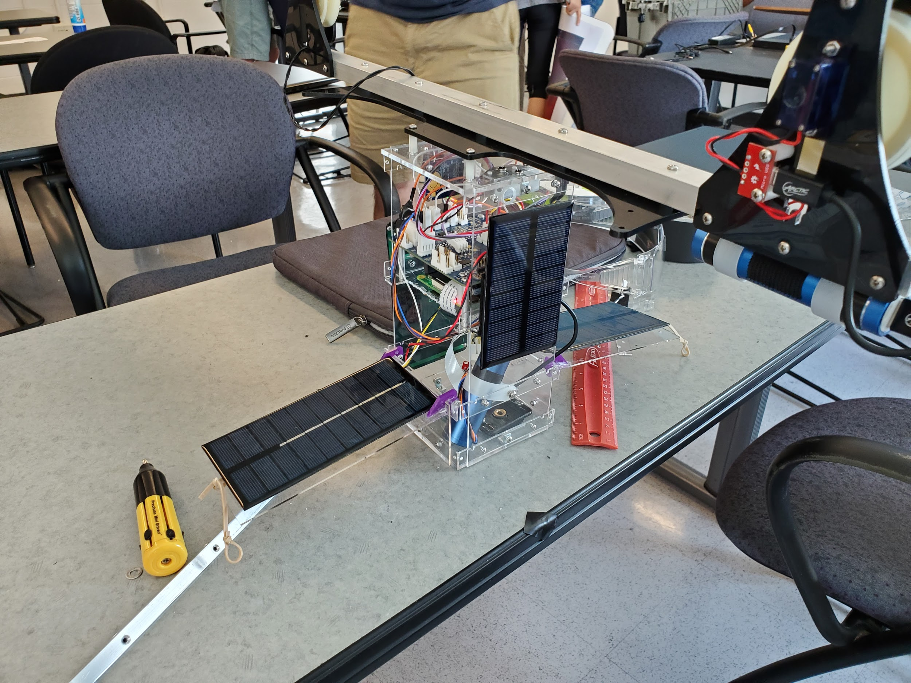
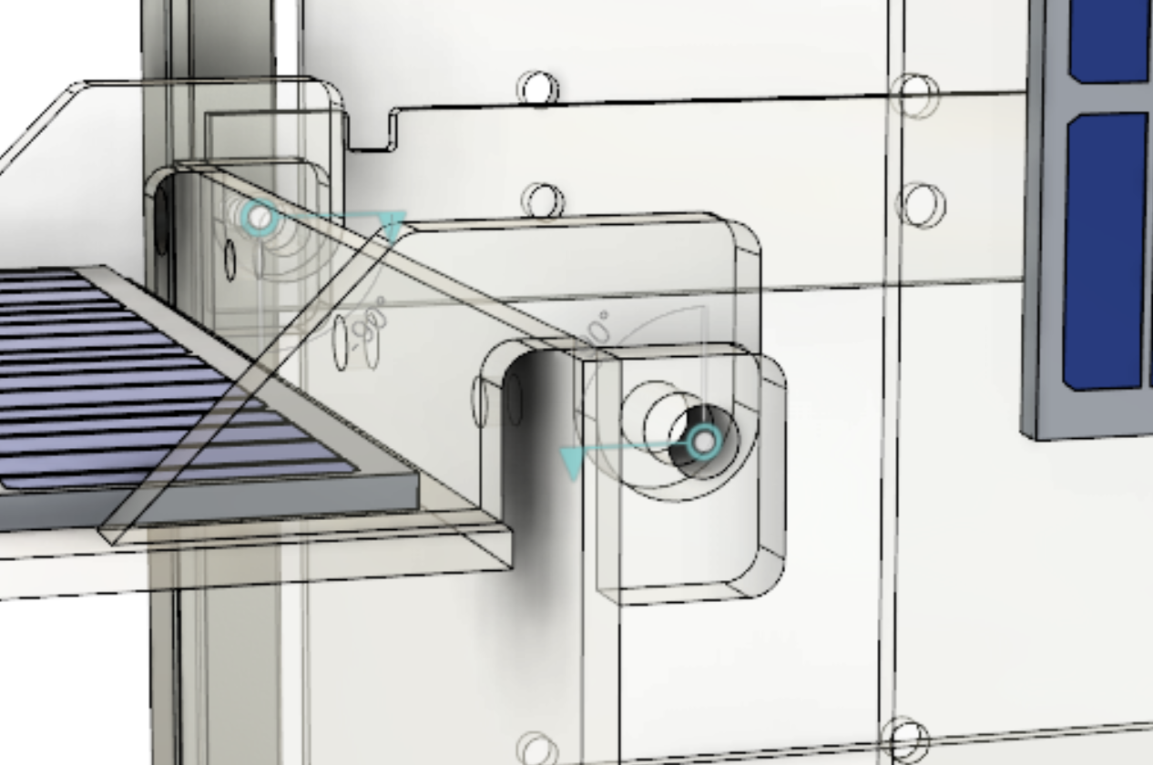
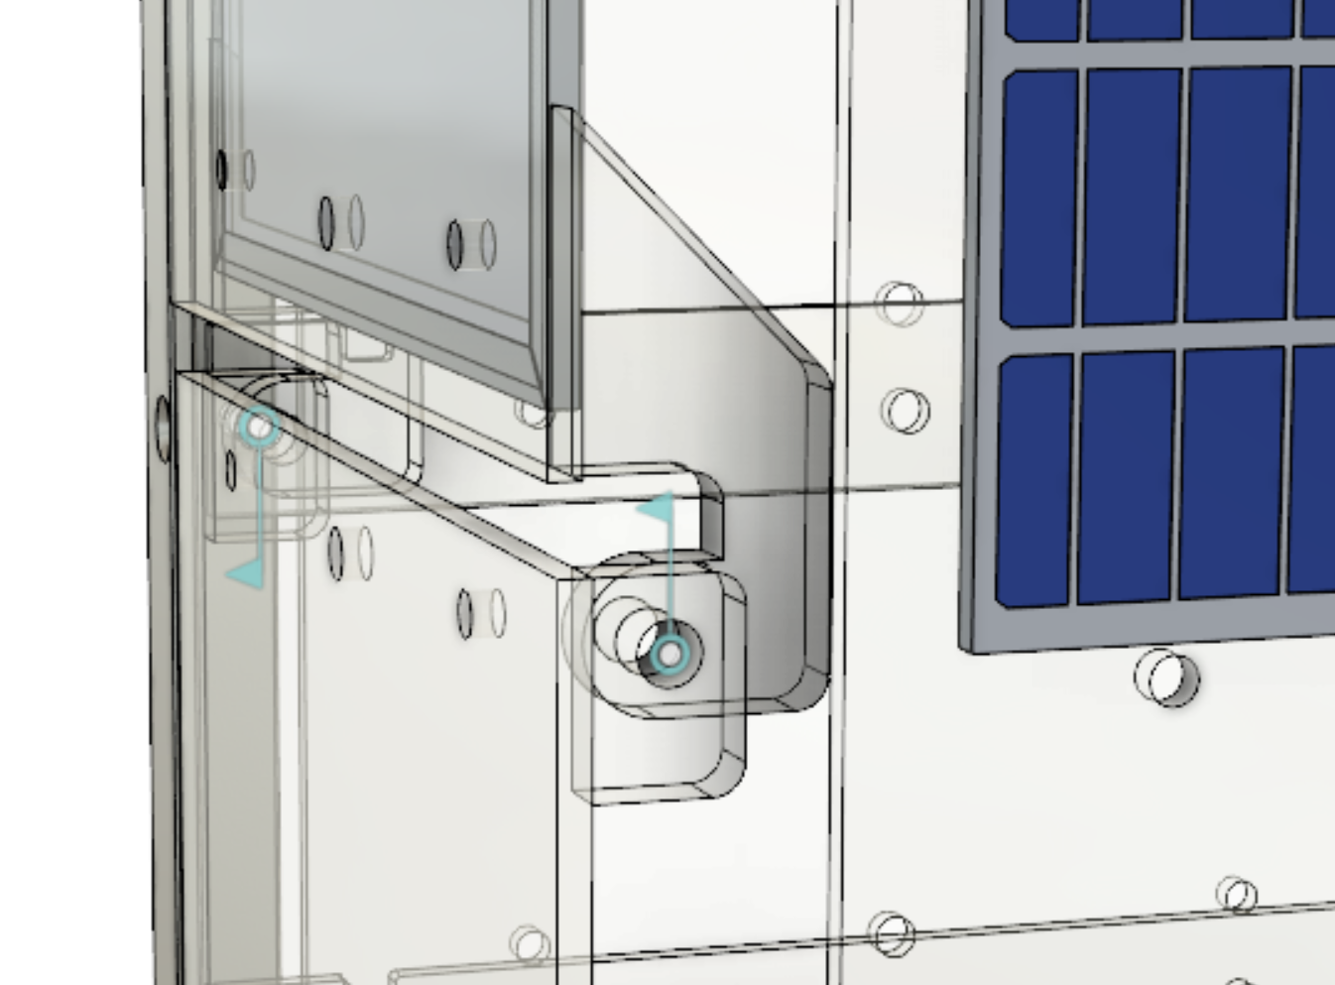
Structural Design Diagrams/Pictures

Slide 4
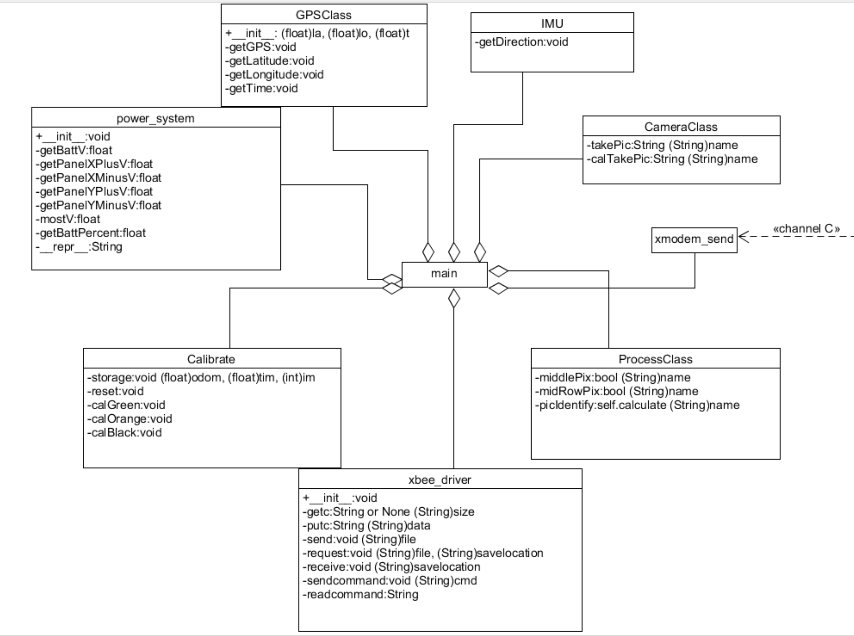

Slide 5
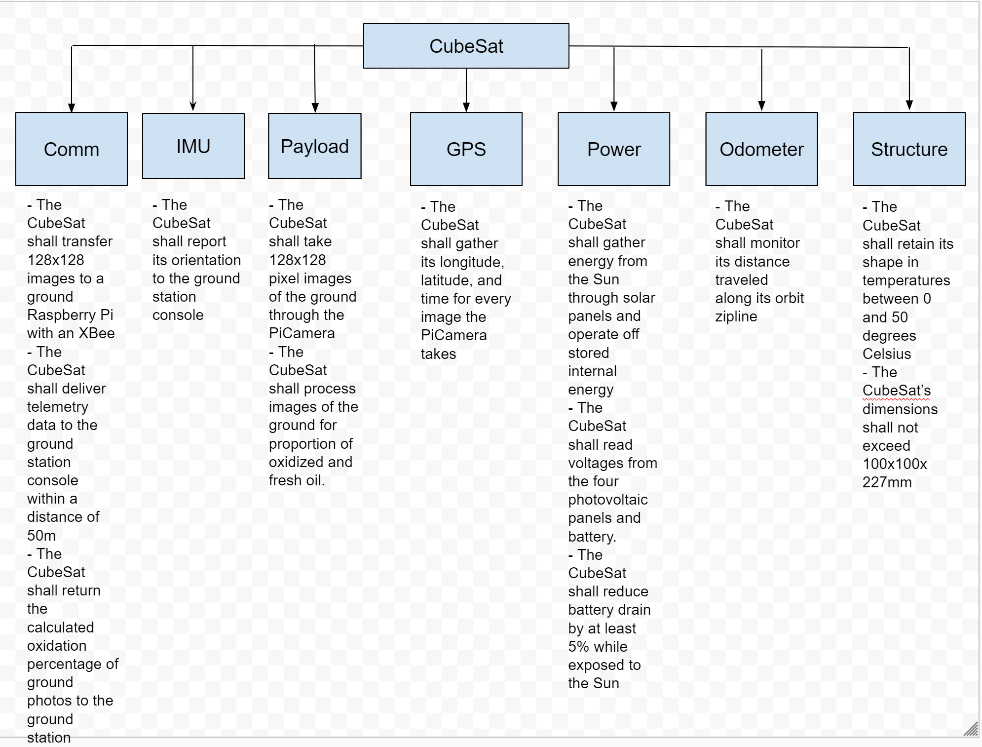

Slide 6
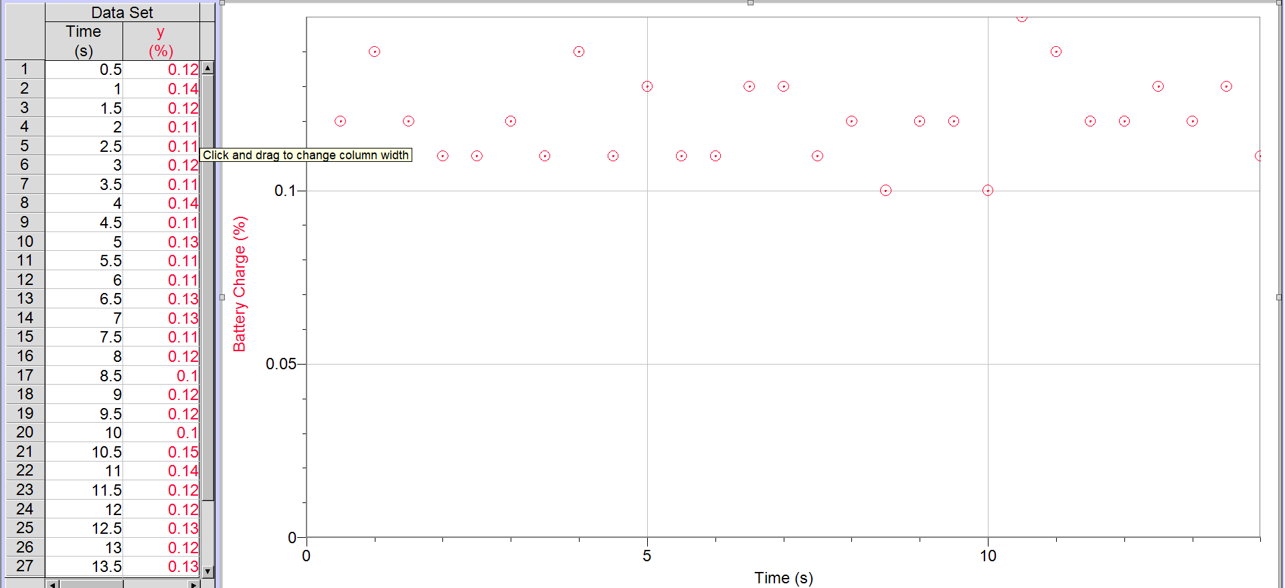
Battery Charge Fluctuation over Time
*Connected to solar panels

Slide 7
Oil Distribution Images from OTIS-2U
Picture 221:
-Oxidation: 0.13% (On board)
-Oxidation: 0.0% (Post-Processing)
-Area to be covered in dispersant: 0%
-fOil: 0
-fOxi: 0
Picture 141:
-Oxidation: 58.3% (Post-Processing)
Area of pan to be covered in dispersant: 6.1%
-fOil: 0.067
-fOxi: 0.094
Picture 130:
-Oxidation: 0% (Post-Processing)
-Area of pan to be covered in dispersant: 100%
-fOil: 1
-fOxi: 0
Picture 28:
-Oxidation: 83.9% (Post-Processing)
-Area of pan to be covered in dispersant: 0.976%
-fOil: 0.01
-fOxi: 0.05
Picture 40:
-Oxidation: 100% (Post-Processing)
- Area of pan to be covered in dispersant: 0%
-fOil: 0
-fOxi: 1
Budgets
Mass Budget
Data Budget
Power Budget
Link Budget
Cost Budget
Materials used: Raspberry PI, ChickenBot Pi, Pololu Minimu, Adafruit GPS, Xbee, Battery, Camera, Solar Panels, Rails, Acrylic Panels, Cables
Estimated Budget: 0.900 Kg with 15% margin error
Actual Mass: 0.720 Kg
-Estimated Storage for 128 x 128 pixels images over 40 orbits: 9.83 ± 2.457 Mb
-Actual storage for 249 images: 12.24Mb
-Estimated time taken to send one 128x128 image: 7.26 seconds + 7 sec margin
-Regulated Battery Output:
5 V, 1 A, 5 W
-Battery Capacity: 8.14 Wh
-Pi running avionics with all hardware attached: 2.72 W
-Estimated Power Consumption: 5V, 1.1Wh, 5.5 Wh
-Actual Power Consumption: 3.8 V, 2.26 Wh
-Received Power: -80 dBm
-Required SNR: -4 dB
-Link Margin: -4.03 dB
-Noise Level: -76 dB
Maximum Range: 50 m
Due to the necessity of another power breakout board ($13.80), the total cost of the CubeSat costs $463.60, with 25% margin of error
Previous estimated cost: $450 (25% margin of error)

Slide 8
Review of Expected Con-Ops
The CubeSat will first power on through the removal of the RBF pin, making the CubeSat “hot”
The solar panels will also “fan out” after the pin is pulled. (see CAD model)
The CubeSat will run the run.py file automatically
Determines if the RBF pin has been removed and the deployment switch has been pressed through GPIO input
The main.py program is executed
On a while loop:
Determine if the CubeSat is on the “AC” leg using IMU Magnetometer
Take a picture every 0.5 seconds
If the picture does NOT have a green pixel in the center AND the picture has green pixels on the border of the image: The image will be analyzed for orange and black pixels onboard, and the percentage of oxidized oil and crude oil will be returned
The usable image will be sent to a ground station Raspberry Pi through the XBees.
After analyzing and sending the image, the Latitude, Longitude, Time, Direction, Battery Percentage, and Battery Voltage will be returned to the console.
Through the odometer, the Distance the CubeSat has travelled will also be returned
If the CubeSat is on the “BC” leg
Using the same algorithm, a picture of the calibration target is analysed to determine shades of Green, Black, and Orange
At the end of the mission, full resolution pictures (1280x720) can be retrieved from the micro-SD card physically

Slide 9
Actual Mission - Differences
The CubeSat failed to power on when the RBF pin was pulled, which resulted in temporary deorbit.
The solar panels did “fan out” after the pin was pulled. (see CAD model)
The CubeSat reentered orbited after the power problem was solved
The CubeSat ran the run.py file automatically with some restarts
Determines if the RBF pin has been removed and the deployment switch has been pressed through GPIO input. This was accounted for when restarting run.py and main.py
The main.py program was executed
On a while loop:
Due to changes in the mission, the IMU was not used to determine which leg the CubeSat was on.
Take a picture every 0.3 seconds
The images were analyzed for orange and black pixels onboard, and the percentage of oxidized oil and crude oil was returned
The usable images were sent to a ground station Raspberry Pi through the XBees (in theory).
After analyzing and sending the images, the Latitude, Longitude, Time, Direction, Battery Percentage, and Battery Voltage were returned to the console (in theory).
Through the odometer, the Distance the CubeSat has travelled was also returned (in theory)
At the end of the mission, the pictures were retrieved from the physical micro-SD card
(talk about what went wrong and what was different from conops)

Slide 10
Data Acquired

Slide 11
Budgets (weight)

Slide 12
Budgets (power)

Slide 13
Budgets (link)

Slide 14
Budgets (data)

Slide 15
Discussion
(errors, what went wrong, unexpected)

Slide 16
Conclusion
CubeSat is the best course at BWSI...

